Slide 1

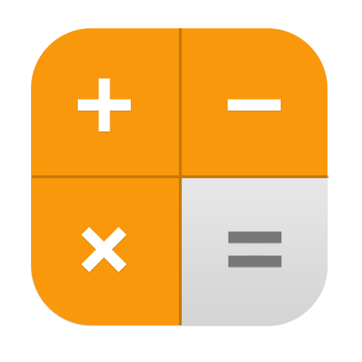
Building a Simple Calculator in Tkinter
Python GUI Development with Tkinter

Slide 2
Introduction to Tkinter
- Tkinter is Python’s built-in GUI library for creating desktop applications.
- It provides widgets like buttons, labels, text boxes, and grids.
- This project demonstrates how to build a basic calculator using Tkinter.

Slide 3
Features of the Calculator
✅ Graphical User Interface (GUI)
✅ Buttons for Digits & Operators (0-9, +, -, *, /)
✅ Clear & Equals (C and =) buttons
✅ Mathematical expression evaluation using eval()
✅ Error handling for invalid inputs

Slide 4
Code Structure Overview
- Importing Required Libraries (tkinter, re)
- Functions:
- get_digit(digit): Updates label with clicked number/operator
- clear(): Clears the display
- calculate(): Evaluates expression safely
- GUI Layout:
- Label for result display
- Grid-based arrangement of buttons

Slide 5
Handling User Input & Calculation
- Safe Input Handling with Regex (re.match)
if re.match("^[0-9+\-*/().]*$", current):
- Evaluating Mathematical Expressions using eval()
- Error Handling (try-except):
except Exception:
result_label.config(text="Error")

Slide 6
Future Improvements & Enhancements
📌 Better UI Design:
- Use Frame and Grid for better spacing
- Different colors for operator buttons
📌 Add More Features:
- Decimal point (.) support
- Keyboard input support
📌 Make it Responsive:
- Use root.resizable(False, False)

Slide 7
Source
GeekforGeek for Tkinter
ChatGPT for Basic knowledge
Youtube for Layout and button management
Online Tutorials
Python Documentation and Libraries

Slide 8
Thank you PrEsented by Jyoti Puri

